Slide 1

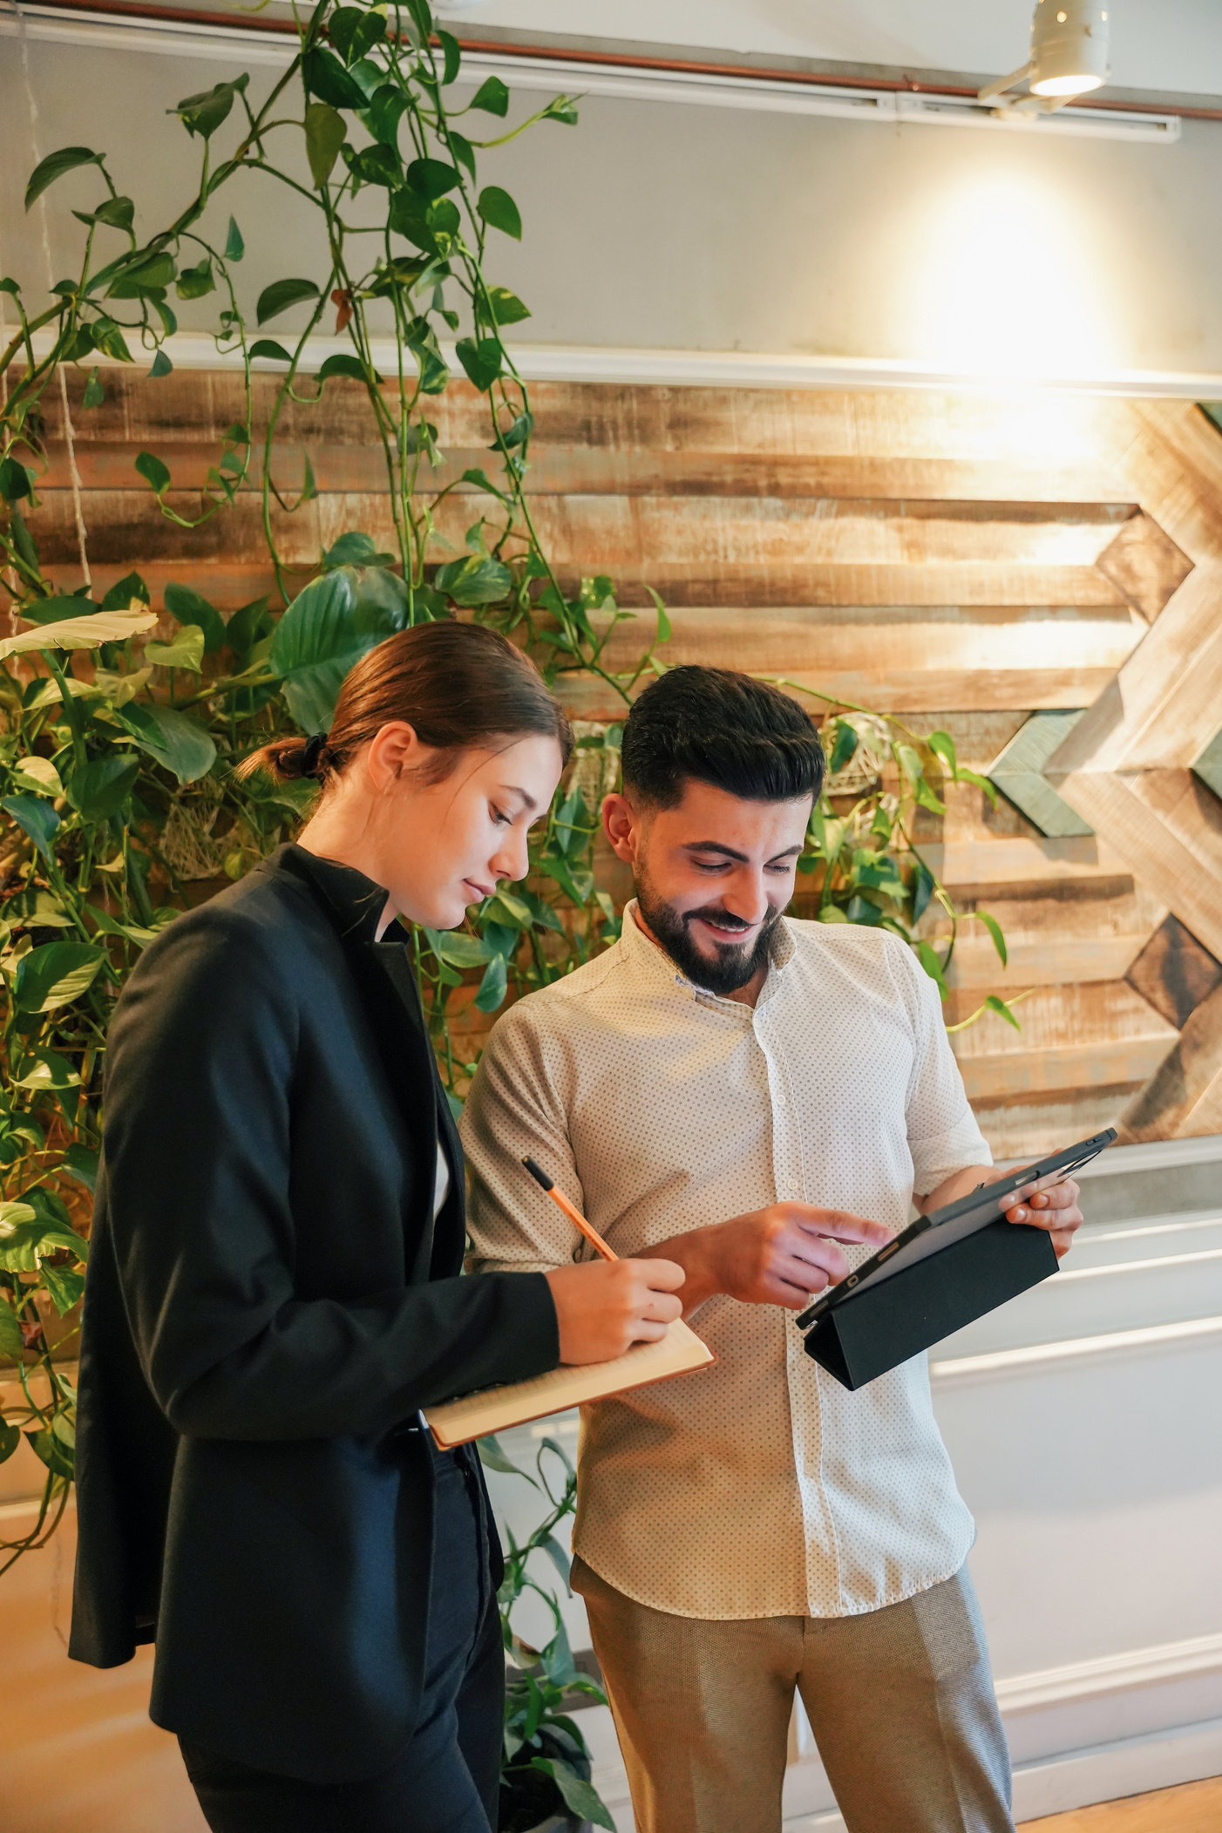
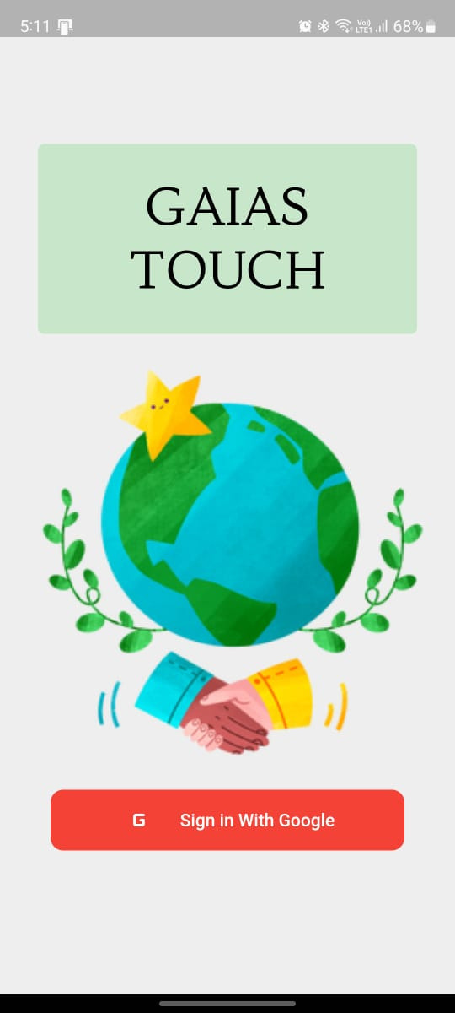

Talent Tank
GAIA’S TOUCH

Slide 2
Content
01
Overview
02
Problem Statement
03
The Solution
04
Market Size
05
Competition
06
Business Model
07
Future Scope
08
Our Team

Slide 3





Overview
01
Many people want we talk to want to help the society improve in some or the other way
But many people in their busy lives lack the time, effort and the resources to do so
02
03
So they decide to help NGOs which are one of the best ways to help people in need and to ensure that the resources are actually going to the needy
But there is a huge absence of any good resources and tools that one can use to know which NGO is the best suited to them and which NGO is not just fake
04

Slide 4


Problem Statement
01
Lack of Proper and trustworthy resources available when trying to find a good NGO to help.
02
Make helping people feel more rewarding
03
Help to support the United Nations Sustainable Development Goals

Slide 5
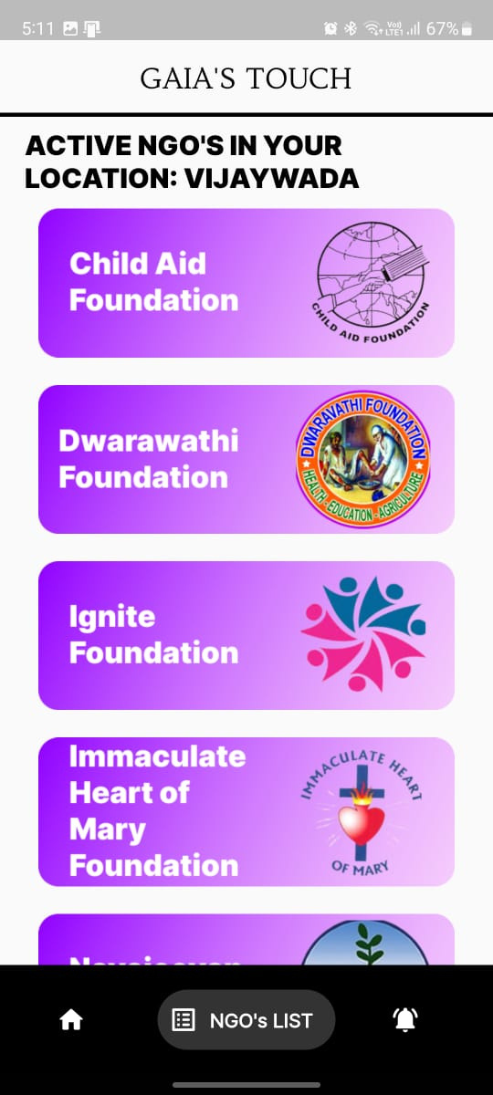
The Solution
01
We created a flutter app that can help bridge the gap between the NGOs and the common people. The app shows you all the NGOs that are currently ACTIVE in your area and view all the details about their work and how to contact them.

Slide 6
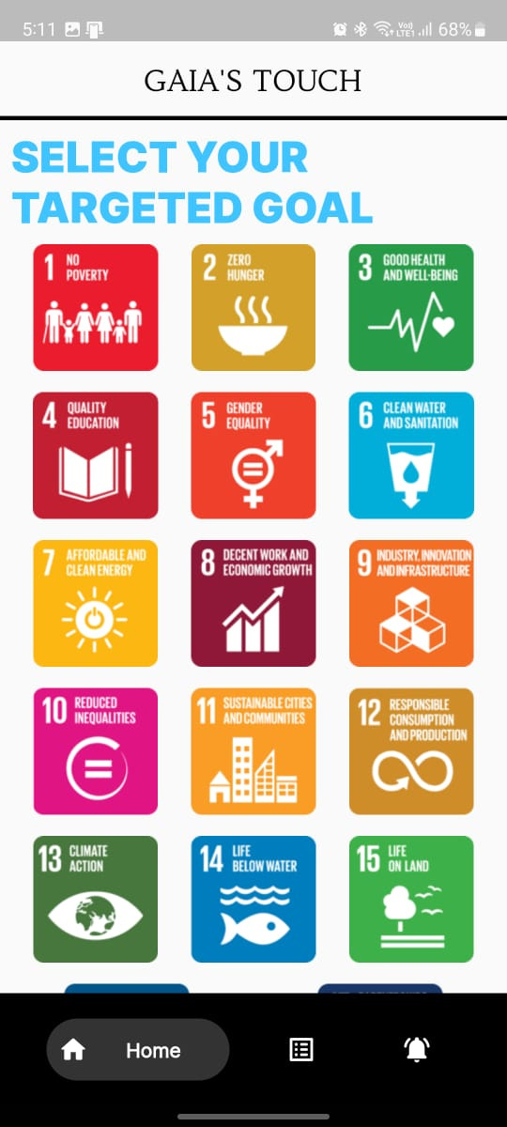
The Solution
02
Users can select the specific sustainable goal they want to help and see the top NGOs nationally that help solve that problem

Slide 7
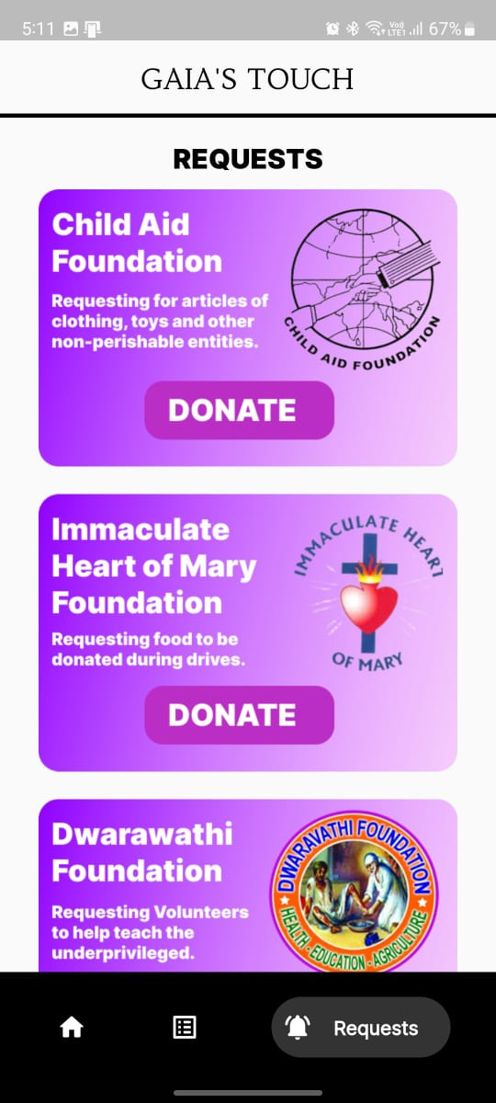
The Solution
03
NGOs can also use this app to request different goods or services for their shelters and events.
People can choose from Physically volunteering at events to sending old clothes, food, stationary or even donating money to them.

Slide 8
Market Size
Approx Rs. 27000 Crore total donations are made in India out of which approx. Rs. 900 Crores is directly to NGOs.
People usually donate 1-2% of their total income to several causes.
Up to 85% of Indians surveyed across cities said they participated in some charitable action related to the pandemic. Two in three gave money or goods to charities or for community services
Sources: LiveMint

Slide 9





Objectives
Objective 01
To make it easier for a person to find a good and trustworthy NGO functioning locally.
Objective 02
GAIA’S TOUCH
Make it easier for NGOs to gather resources and volunteers for their drives and events
Objective 03
Make the act of helping people in need and social service feel rewarding to people.
Objective 04
Create a trustworthy platform that makes it even easier to donate money to the NGOs

Slide 10

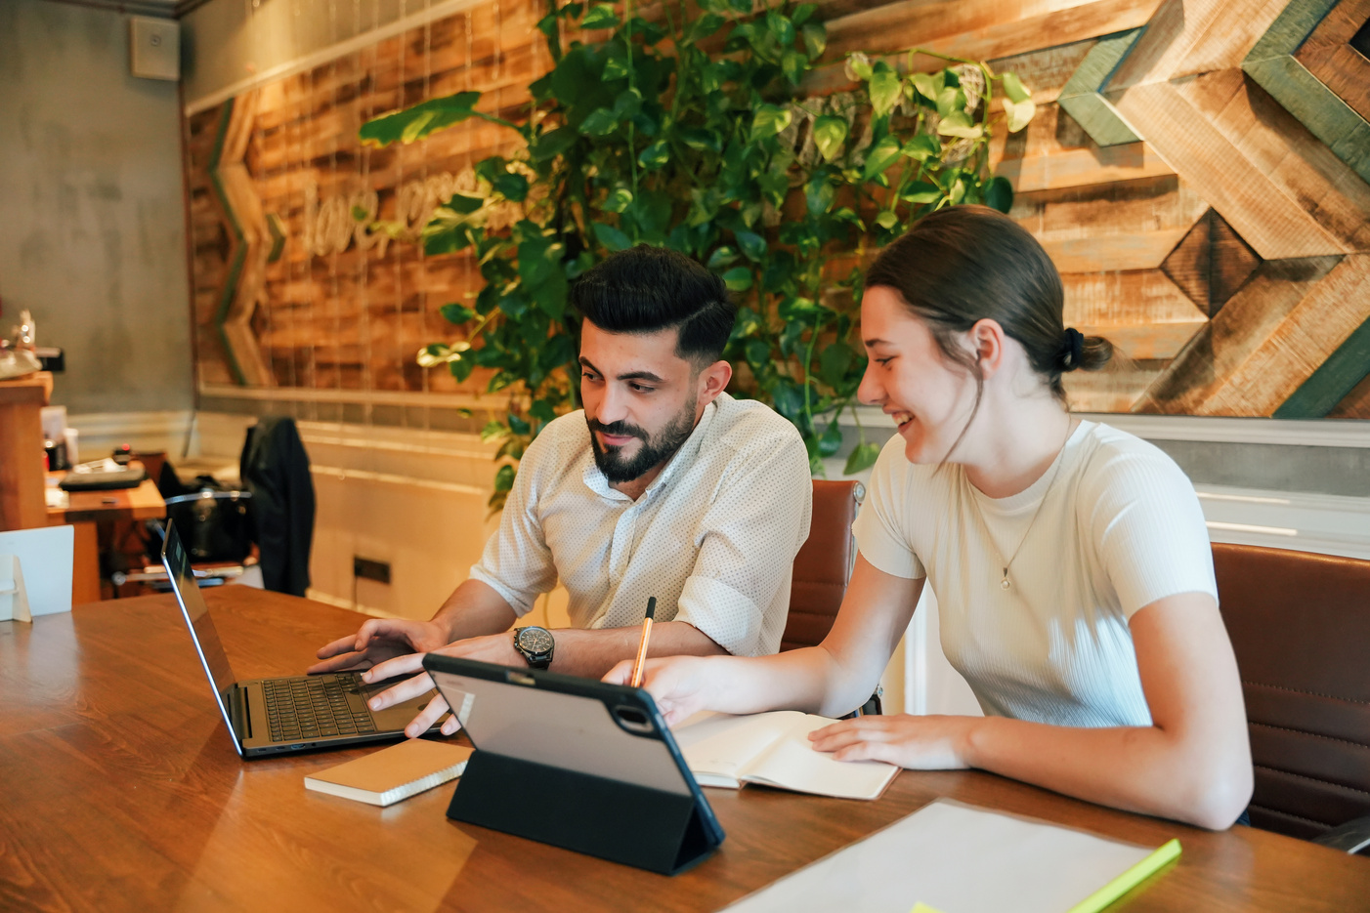

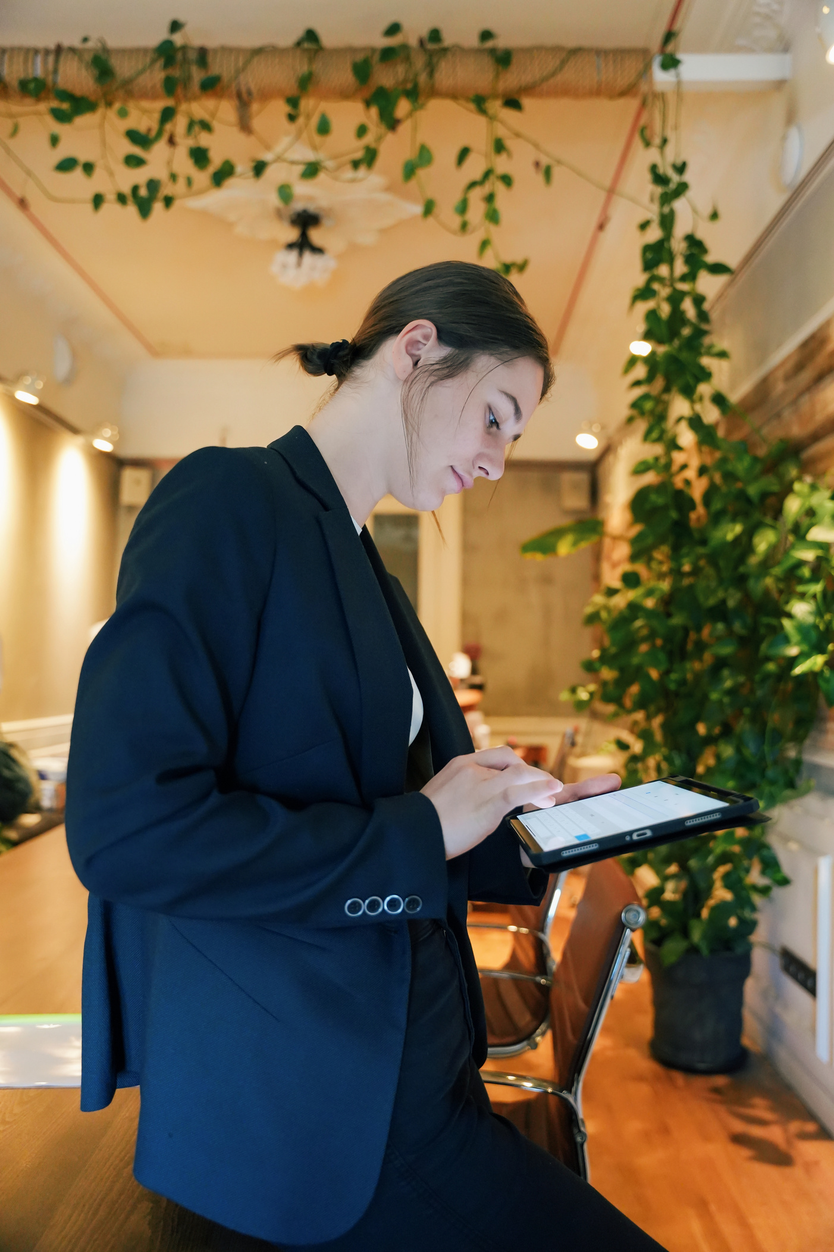
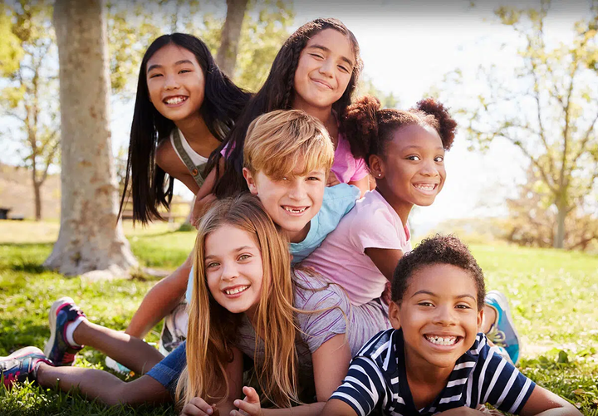
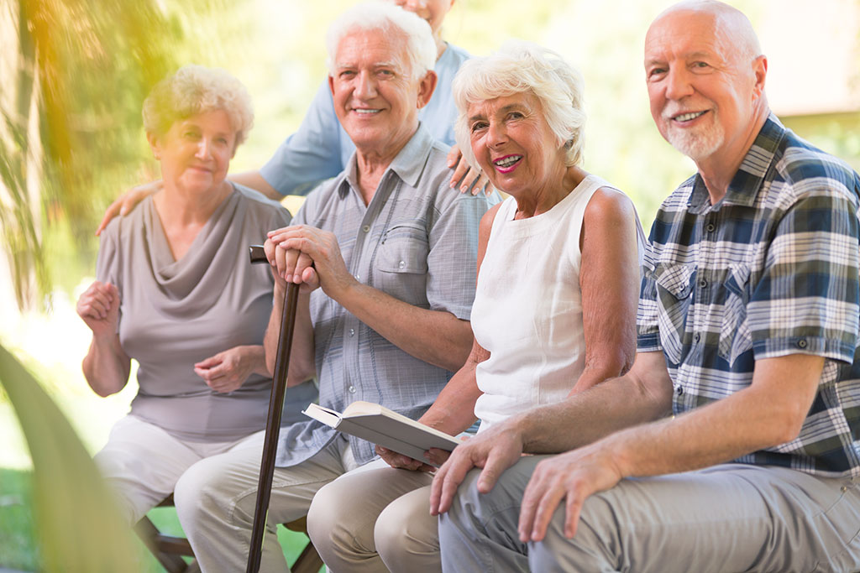
Target Audience
Youngsters
Working Adults
Youngsters
Senior Citizens
Children in schools and colleges can use this app to register for local drives or donate their old clothes or stationary
Adults who are busy with their work/offices and are not able to get free time to help others can use this app to donate or crowdfund NGOs
Many senior citizens after retirement want to give back to society they can use this easy to use app to register and volunteer for different NGOs

Slide 11

Competition
The only available competition out there is Milaap.org
That is a platform where users can start fundraisers, lending and donating money.
Our platform is different because we provide users data specific to their location and ngos can not only request money but also ask for food, clothes and even volunteers

Slide 12
We are a nongovernmental nonprofit organization running the app maintaining and running an app on a big scale requires investment to cover our functional fee so our business model follows:
Main sources of Income
Minimal donation of Rs. 10-20 on each donation. That is completely optional for the user to make he/she can opt-out during the payment page.
Brand Integrations so that users can redeem points to get small rewards.
Business Model

Slide 13
Application Making and Maintenance: Rs.35,000
Hosting and Database: Rs. 40,000
Advertisement and promotion: Rs. 70,000
Manual Verification Of NGOs: Rs. 25,000
Total Operational Cost(approx.) = 2 Lakh Rupees
OPERATIONAL COSTS

Slide 14
Future Scope
In the future we plan on adding:
A points system that awards points to users on how active they are on the platform and those points can be used to redeem different products or vouchers from our partnered brands.
NGOs can reach us out to organize or host events with us.

Slide 15

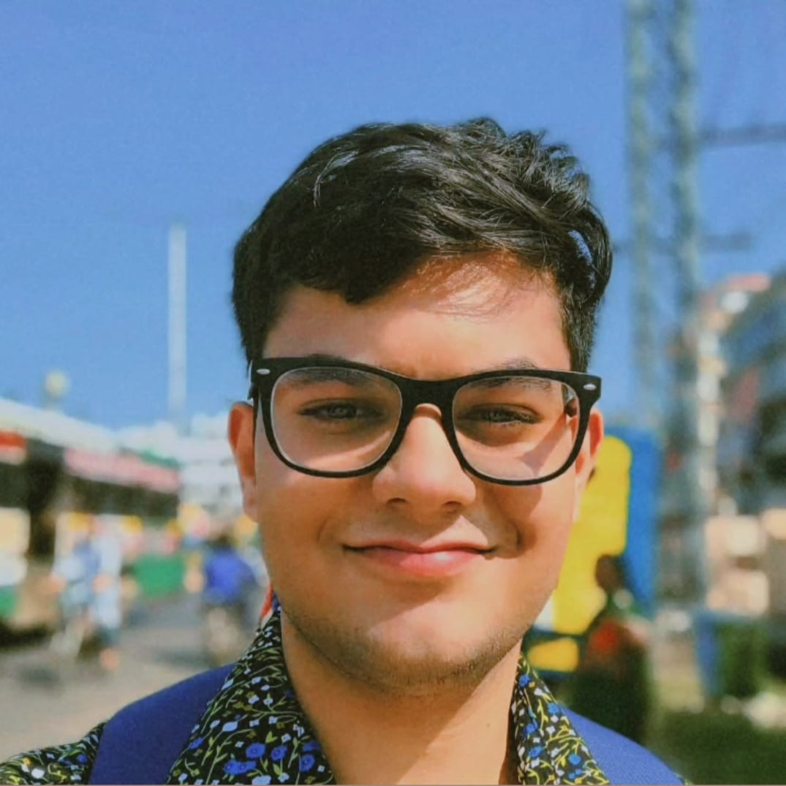

Our Team
Aryan Gupta
Radha Krishna Garg
Md. Anas Jamal

Slide 16
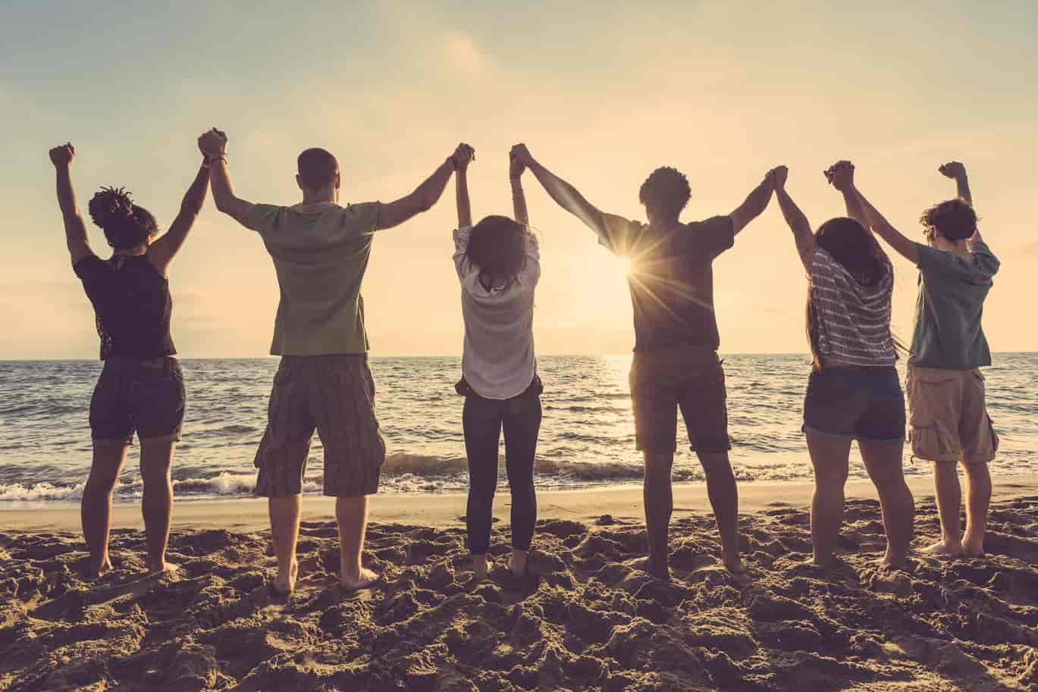
GAIA’S TOUCH
THANK YOU

